Slide 1
Pleasure purpose study
2 Nov 2015

Slide 2

How are purpose and pleasure integrated in making choices about how to spend your time?
Stimuli: 80 descriptions of events Procedure
Session 1: Rate each event (pleasure, purpose)
Session 2 (fMRI): Choose between events
Session 3: Choose between events outside the scanner
Pairing of choice options (session 2) was via sampling:
Shuffle all available ratings, pick out pairs that make opposite predictions (e.g. choose Opt1 on PP, Opt2 on PL) [Incompatible choice trials]
Doesn’t care about extent of differences (e.g. +1 vs -1 is considered the same as +5 vs -1)
Every event paired in 2 different trials in session 2
Mean no. conflict trials =36.75, SD=15.2

Slide 3
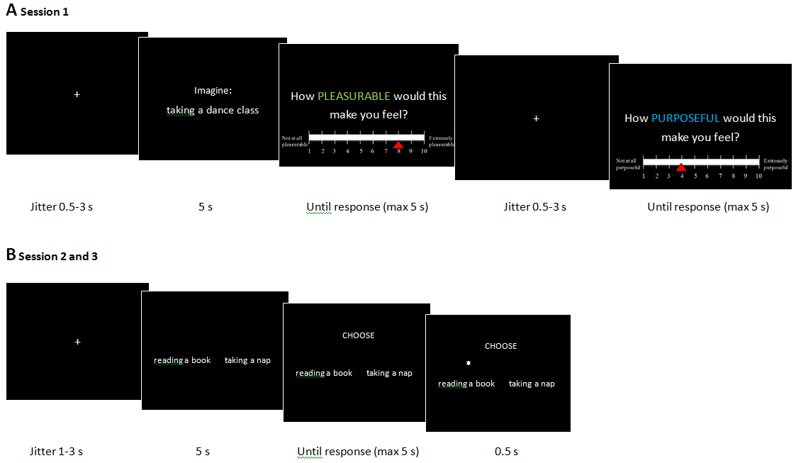
Method - Procedure
We define PLEASURABLE as bringing you positive feelings, such as joy, happiness, or contentment.
We define PURPOSEFUL as feeling meaningful, worthwhile, or fulfilling.

Slide 4
Basic stats
B-coefficients for PL and PP
(all trials)
% decisions based on PL or PP
(under conflict)
subject | PL | PP
1 | 0.491 | -0.168
2 | 0.466 | 0.201
3 | 0.512 | -0.057
4 | 1.621 | -0.024
5 | 0.444 | 0.101
6 | 0.142 | 0.116
7 | 0.143 | 0.401
8 | 1.15 | -0.108
9 | 0.355 | 0.008
10 | 0.497 | 0.077
11 | 0.635 | 0.089
12 | 0.215 | -0.016
13 | 0.667 | -0.199
14 | 0.436 | -0.007
15 | 1.912 | 0.502
16 | 0.209 | 0.047
17 | 0.11 | 0.027
18 | 0.332 | 0.034
19 | 0.499 | -0.139
20 | 0.283 | 0.071
mean | 0.556 | 0.048
Single regression | 0.419 | -0.004
subject | PL higher | PP higher
1 | 82.10% | 17.90%
2 | 65.90% | 34.10%
3 | 76.00% | 24.00%
→ 4 | 93.50% | 6.50%
5 | 72.20% | 27.80%
6 | 48.10% | 51.90%
7 | 45.50% | 54.50%
→ 8 | 95.70% | 4.30%
9 | 78.60% | 21.40%
10 | 77.40% | 22.60%
11 | 72.70% | 27.30%
12 | 61.70% | 36.20%
13 | 73.10% | 26.90%
14 | 76.20% | 23.80%
→ 15 | 92.60% | 7.40%
16 | 64.70% | 35.30%
17 | 58.10% | 41.90%
18 | 66.70% | 33.30%
→ → 19 | 100.00% | 0.00%
20 | 66.70% | 33.30%
mean | 73.40% | 26.50%
SD | 14.70% | 14.70%
2 groups: PL-driven group v.s. PL&PP group
Notes:
Values highlighted in orange are significant.

Slide 5
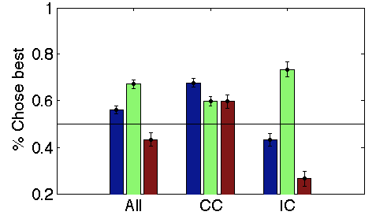
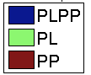
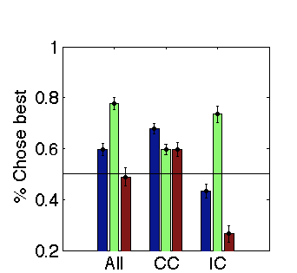
Comparing trials where choice is clear vs choice is conflicted
Subjects overweight pleasure when behavioural conflict occurs
There is still a lot of variance to be explained (peaking at about .8)
CC: Compatible Choice
IC: Incompatible Choice
PL: Pleasure
PP: Purpose
No draws in PP or PL
Incompatible choice
(Behavioural conflict)
CC: The PLPP bar here is higher than the others (even when draws in PL/PP are deleted) because sometimes, PL+PP leads to draws at the PLPP level (which are then ignored for this index), which means that the no. of cho-PLPP is divided by a smaller number
Notes:
2x2 (PLPP x Conflict) ANOVA: Mes & interaction all v sig.

Slide 6
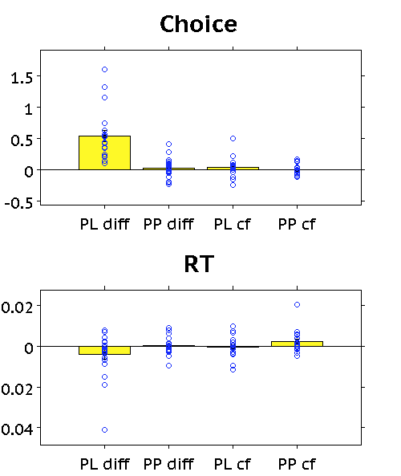
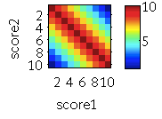
1. Regression analysis (all trials) PL is more important to choice, but PP-domain conflict leads to RT slowing
p<.001
Value diff in Pleasure domain affects choice
Value conflict in the Purpose domain slows RT
p=.0491
Note. One has to z-score these to get these results, not log-transform (as stated throughout the slides). I think this may have been an earlier bug. Not followed up on because the regression analysis is not super productive.
Rerunning the regression analysis on binned scores is also not productive.
Note: p19’s PP cf beta on RT is an outlier (>3SD from mean). Removal leaves a statistical trend (p=.0543), use of a Wilcoxon signed rank test is still sig (p=.043)
Notes:
How robust is the RT effect?
- Outlier RTs are first removed and remaining RTs are log-transformed (within subject) before analysis
- If I zscore rather than log-transform, result is the same (and the apparent outlier in betas is pulled in as well)
- If I mean centre RTs instead, no RT effects

Slide 7
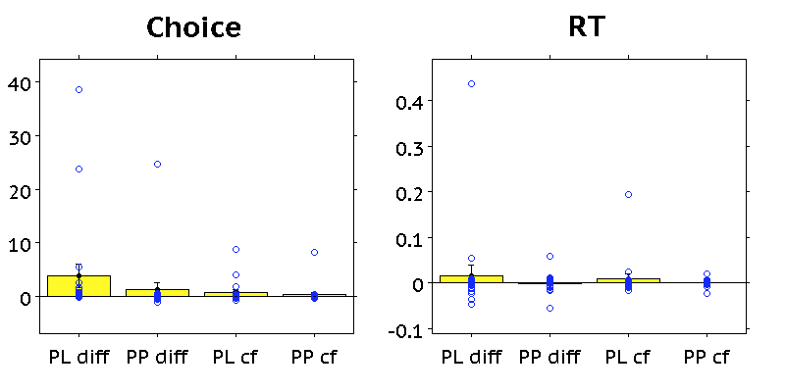
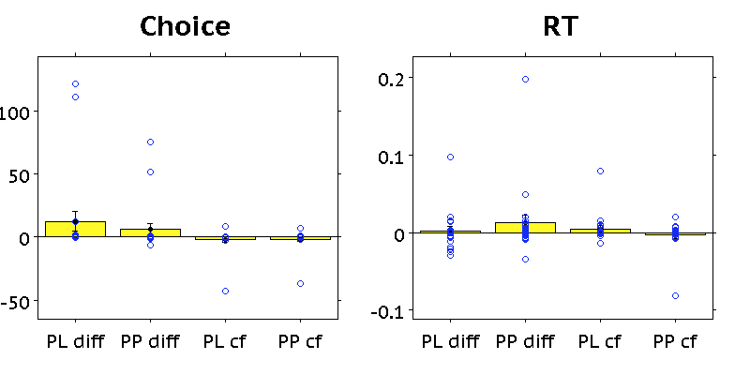
1. Regression analysis (split trials)
Compatible Choice trials
p=.089
Incompatible choice trials
Notes:
How robust is the RT effect?
- Outlier RTs are first removed and remaining RTs are log-transformed (within subject) before analysis
- If I zscore rather than log-transform, result is the same (and the apparent outlier in betas is pulled in as well)
- If I mean centre RTs instead, no RT effects

Slide 8
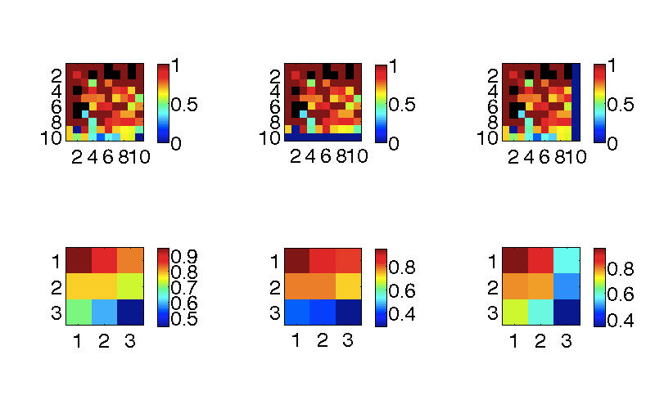
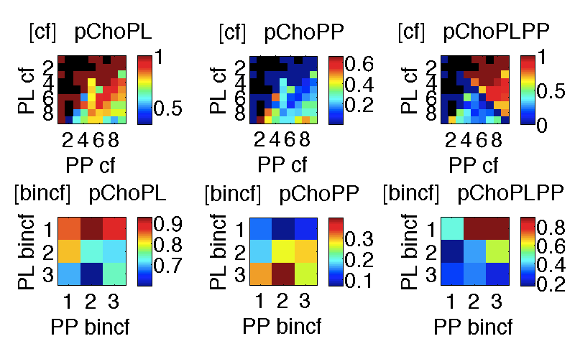
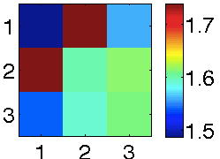
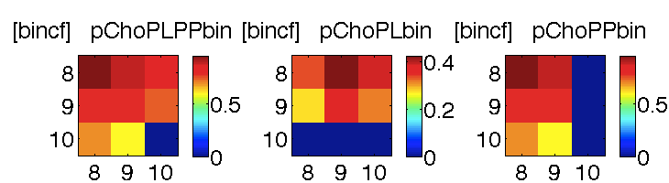
2. On compatible-choice trials, conflict in both domains affects the likelihood of making the best choice
p(Choose agree w PLPP)
Note that the IV here (and for all presented analysis) is cf calculated on the binned scores, whereas the DV is on the un-binned scores. If the DV is calculated on the binned scores, pattern is similar (below).
If scores are binned at source, pattern is again similar, but less distinct
Only cf-based analysis on pCho has been looked at, not the other Ivs
Un-binned scores
RTs
Notes:
PLcf x PPcf fx: pChoPLPP
ME PLcf: p= 4.4265e-13
ME PPcf: p= 0.011644
PLxPP cf: p= 4.2129e-07
--------------
PLbincf x PPbincf fx: pChoPLPP
ME PLbincf: p= 2.3639e-05
ME PPbincf: p= 0.052649
PLxPP bincf: p= 0.22963
--------------

Slide 9
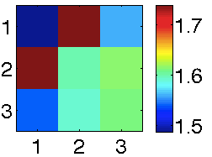
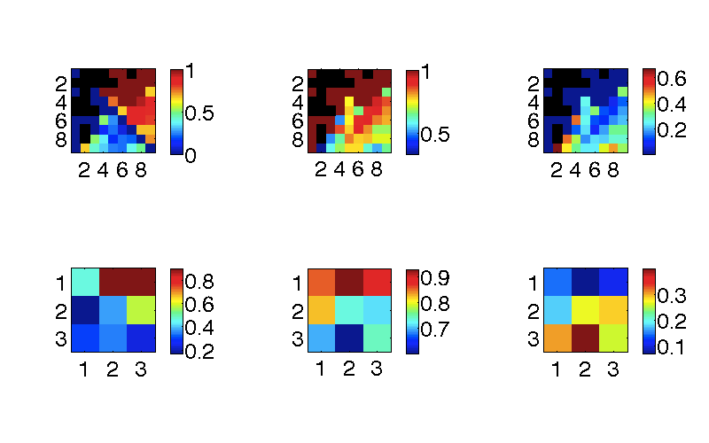
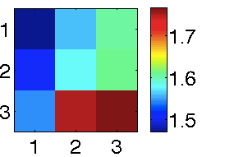
3. PP-conflict’s effect on choice disappears on IC trials, but it continues to exert influence
IC trials:
PL/PP conflict leads to RT slowing, but more so for the purpose domain
→ Going against the typical value integration is computationally costly
p(Choose agree w PLPP)
p(Choose agree w PP)
RT
p(Choose agree w PL)
Compatible Choice trials
Incompatible Choice trials
faster
(more) faster

Slide 10
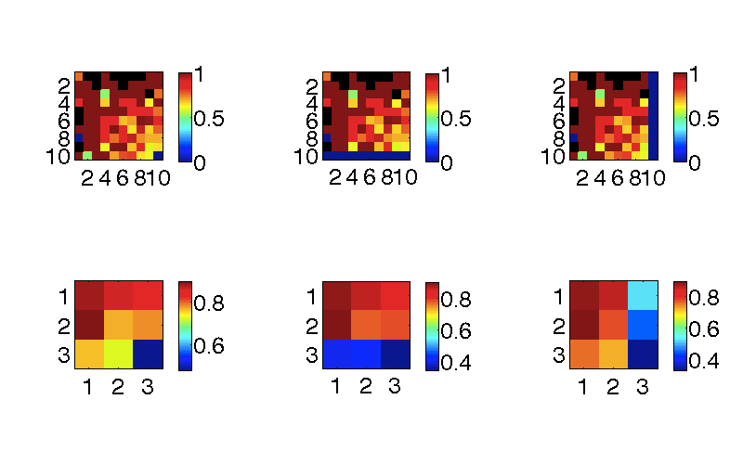
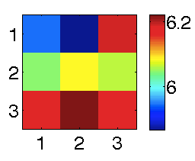
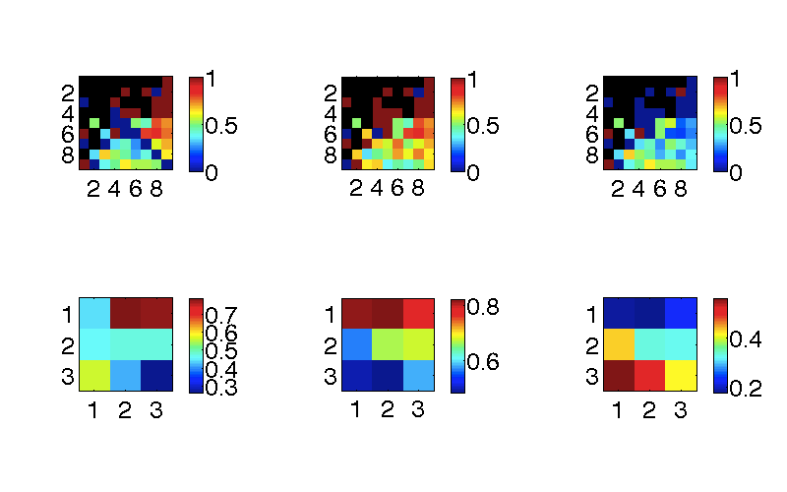
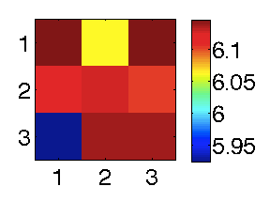
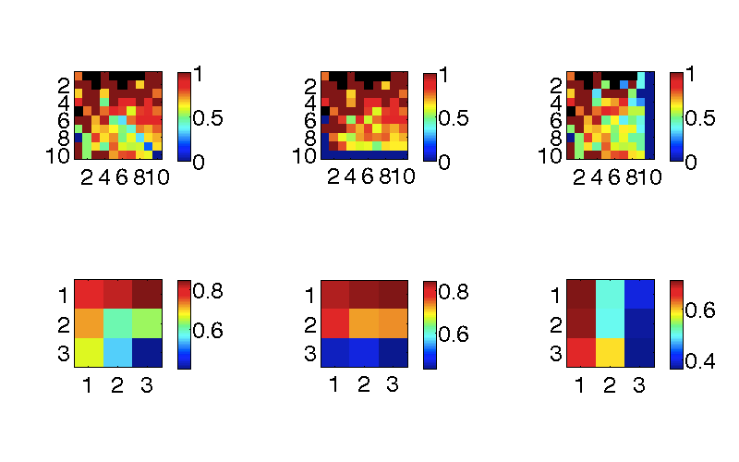
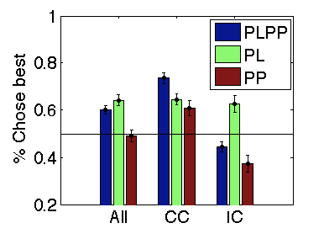
4. Do we find the same pattern in the behavioural pilot data?
Faster RT
Faster RT
p(Choose agree w PLPP)
p(Choose agree w PP)
RT
p(Choose agree w PL)
Compatible Choice trials
Incompatible Choice trials
0.8845 | 0.8619 | 0.8385
0.9 | 0.7735 | 0.7866
0.7652 | 0.7257 | 0.4787
All trials

Slide 11
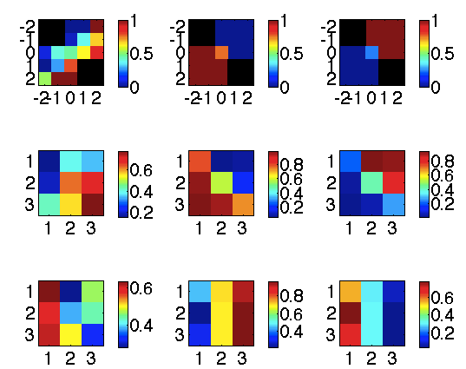
5A. Choice on IC trials
p(Choose x)
Chose max PLPP
Chose max PL
Chose max PP
IV:
Chosen > Unchosen
Subjects weight PL & PP most equally when both are valuable
IV:
Chosen
As the counter-factual gets more purposeful, choice gets worse ??
May be because PL and PP scores are correlated across events
IV:
Unchosen

Slide 12
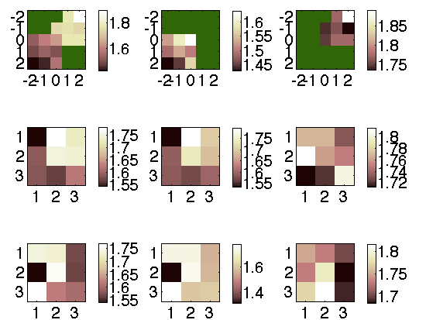
5B. IC trials: RTs (different scales)
Log(RT)
All trials
Chose max PL
Chose max PP
IV:
Chosen > Unchosen
IV:
Chosen
IV:
Unchosen

Slide 13
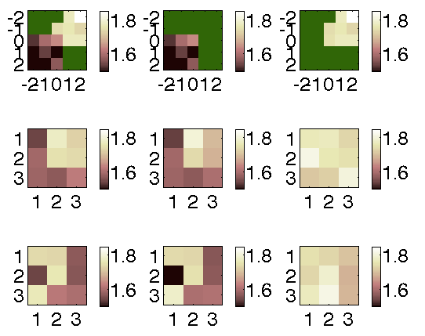
5B. IC trials: RTs (same scales)
Log(RT)
All trials
Chose max PL
Chose max PP
IV:
Chosen > Unchosen
IV:
Chosen
IV:
Unchosen

Slide 14
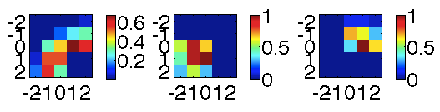
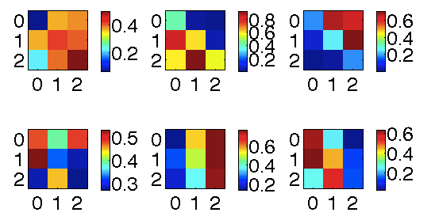
5D: Pilot data: Choice on IC trials
p(Choose x)
Chose max PLPP
Chose max PL
Chose max PP
IV:
Chosen > Unchosen
IV:
Chosen
IV:
Unchosen

Slide 15
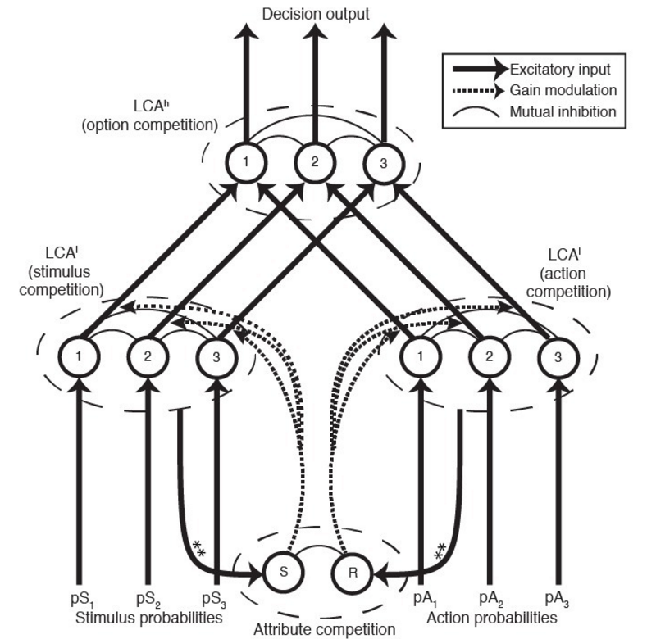
Hierarchical LCA
PP and PL each get a (quantitative) ‘vote’, vote is then integrated
When vote integration does not happen smoothly (incompatible votes), → over-ride
Headline: Try the LCA first because it gives the best chance of a maximally mechanistic model-fit.
If nothing can be done with the LCA, then resort to simple descriptive models (which do not allow for satisfying RT explanations)
Hierarchical competition model

Slide 16
END

Slide 17
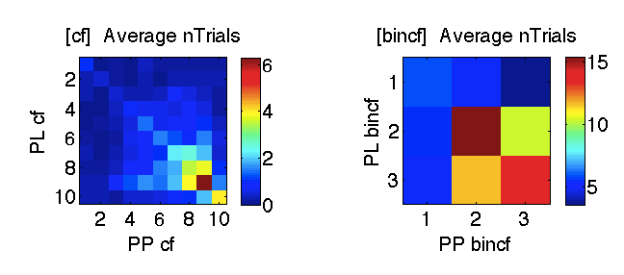
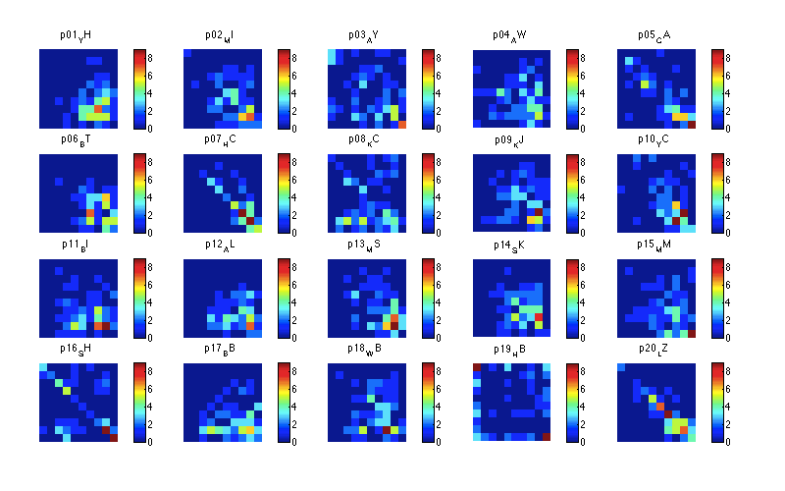
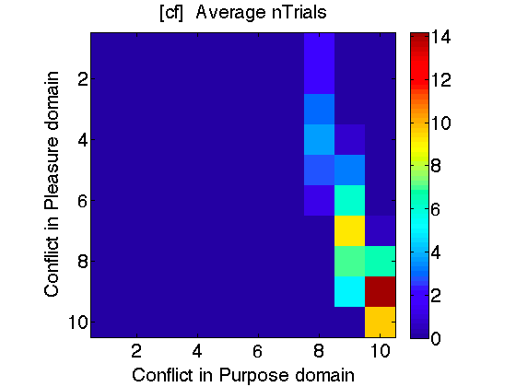
Balance in the PL & PP dimensions (design-wise)

Slide 18
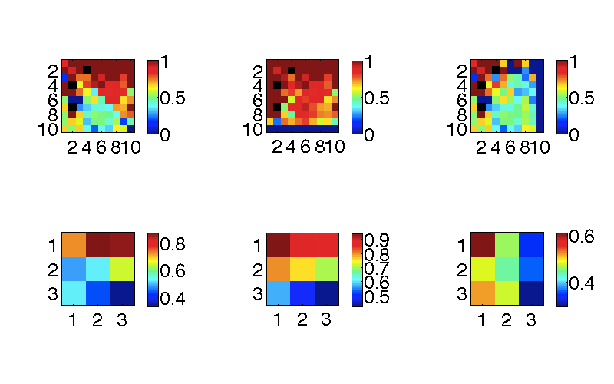
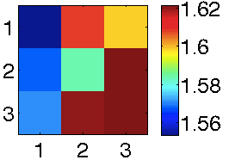
Effect of within-domain conflict on choice
p(Choose agree w PLPP)
p(Choose agree w PP)
RT
p(Choose agree w PL)
All trials
Compatible Choice trials
Incompatible Choice trials
faster
more faster

Slide 19
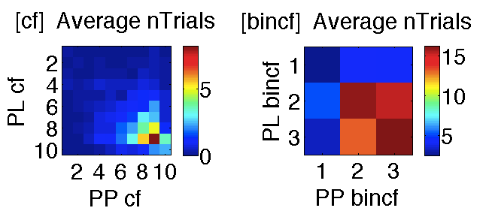
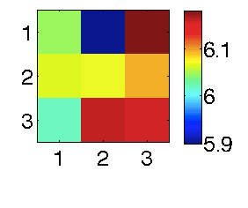
Pilot data
Faster RT
Faster RT
p(Choose agree w PLPP)
p(Choose agree w PP)
RT
p(Choose agree w PL)
Compatible Choice trials
Incompatible Choice trials
All trials

Slide 20
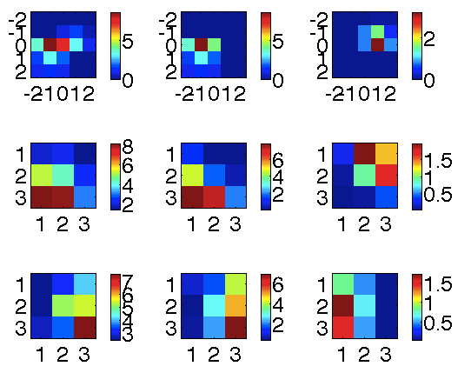
IC trials – N trials
All trials
Chose max PL
Chose max PP
IV:
Chosen > Unchosen
IV:
Chosen
IV:
Unchosen

Slide 21
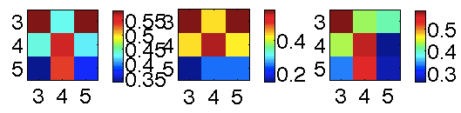
Other simulations
p(Choose agree w PLPP)
p(Choose agree w PL)
p(Choose agree w PP)
Randomize choice
Notes:
X and y labels are different from the other slides for unimportant reasons

Slide 22
Other ad-hoc questions

Slide 24
END

Slide 25
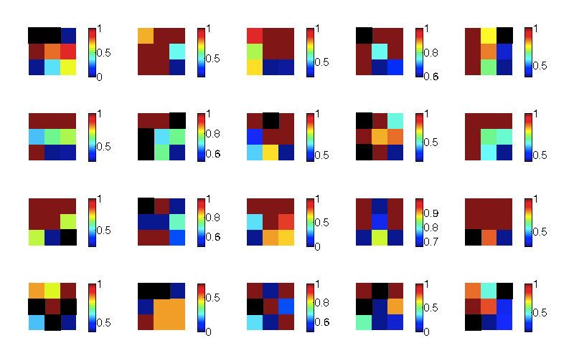
Individual subject patterns are less clear

